Slide 1
Conditional Access deep dive into policy enforcement
Caleb Baker, Principal Product Manger Azure AD Conditional Access
2/16/2023

Slide 2
Disclaimers
This is intended to be a 400-level talk. This is not an introduction to Conditional Access.
The purpose of the talk is for you to gain practical knowledge about current behaviors.

Slide 3
Topics
Cloud app policy assignment
Excluded apps and services
Microsoft services
Microsoft Graph API
Recommendations

Slide 4
Approach to protecting resources
Conditional Access policy to secure access to resources using session context
e.g. check strong auth, device, location and sign-in risk
Examples resources
Files | Mail | Chat
Admin tasks | Web sites | Services endpoints

Slide 5
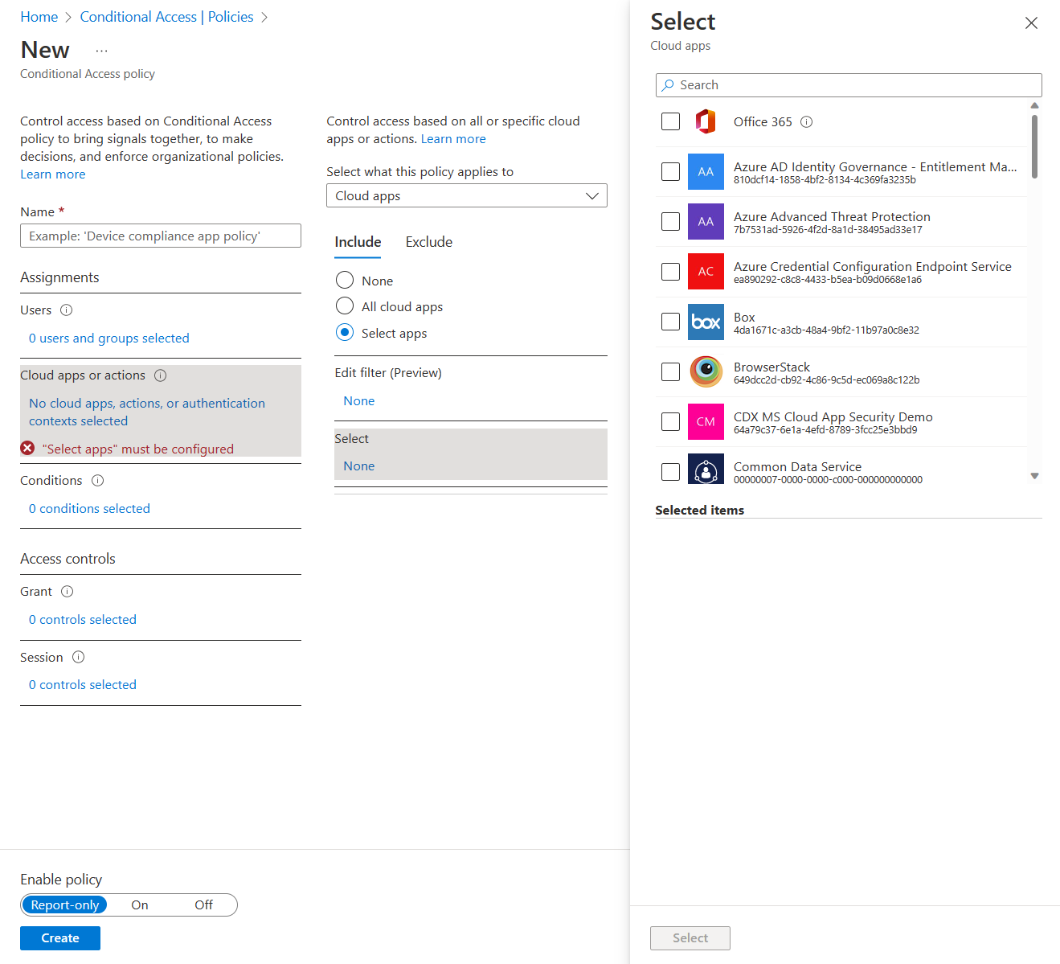
Cloud Apps

Slide 6


What are cloud apps?
Cloud apps ARE |  | Cloud apps ARE NOT
Web sites OpenID Connect / OAuth 2.0 confidential clients SAML |  | Mobile or desktop apps OpenID Connect / OAuth 2.0 native clients
Web services APIs

Slide 7


Policy enforcement (OpenID Connect)
Conditional Access policy enforced
Conditional Access policy doesn’t apply
Sign-in token
(id_token)
Delegate access token
(access_token)
Web service
Web Site
Sign-in token
(id_token)
Delegate access token
(access_token)
Web service
Mobile and desktop app

Slide 8
Demo : policy enforcement on cloud apps
Web site
https://login.microsoftonline.com/organizations/oauth2/v2.0/authorize?redirect_uri=https%3A%2F%2Fmicrosoft.com&response_type=code%20id_token&scope=openid%20email%20profile&client_id=0ba65027-1a14-4f2c-93f8-5a257bf27ab4&nonce=123
Desktop app
https://login.microsoftonline.com/organizations/oauth2/v2.0/authorize?redirect_uri=https%3A%2F%2Flogin.microsoftonline.com%2Fcommon%2Foauth2%2Fnativeclient&response_type=code%20id_token&scope=openid%20email%20profile&client_id=537cd77e-3fad-4a20-ad92-08e59cb8f58e&nonce=123

Slide 9
Policy enforcement (OAuth 2.0)
Conditional Access policy enforced
Conditional Access policy doesn’t apply
OAuth 2.0 response
Delegate access token
(access_token)
Web service
Web Site

Slide 10
Demo : Cloud Apps using OAuth 2.0
Web site
https://login.microsoftonline.com/organizations/oauth2/v2.0/authorize?redirect_uri=https%3A%2F%2Fmicrosoft.com&response_type=code&scope=files.read.all&client_id=0ba65027-1a14-4f2c-93f8-5a257bf27ab4&nonce=123

Slide 11
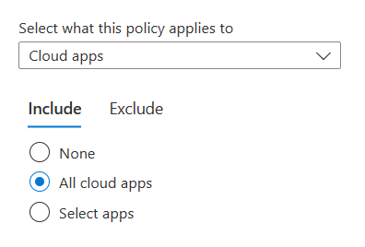
Policy enforcement on all cloud apps
Conditional Access policy enforced
Conditional Access policy doesn’t apply
Sign-in token
(id_token)
Delegate access token
(access_token)
Web service
Mobile and desktop app

Slide 12
Microsoft services in the cloud app picker
Only app/services that have opted in are listed
Opted in services have been identified as customer facing
Some have grouped appIDs for a better experience
Advanced configuration with filters for apps

Slide 13
Policy exclusions for bootstrap services
Policy is not enforced for bootstrap services, that would cause policy deadlocks or broken onboarding
Examples
Exclude device enrollment from policy that requires a compliant device
Exclude passwordless registration from the authenticator, when MAM policy is required
App | AppID
Device registration | 01cb2876-7ebd-4aa4-9cc9-d28bd4d359a9
Intune Management Setup | 0a5f63c0-b750-4f38-a71c-4fc0d58b89e2 OR b642c013-22f8-419d-af11-8f0e05b795e6
Intune Check-In | 26a4ae64-5862-427f-a9b0-044e62572a4f
Multi-Factor Auth Connector | 1f5530b3-261a-47a9-b357-ded261e17918)

Slide 14
MS Graph API

Slide 15




Microsoft Graph API
MS Graph API

Slide 16
Example mappings
App | Scopes
Azure AD 00000002-0000-0000-c000-000000000000 | Directory.ReadWrite.All Directory.Read.All User.Read.All Application.Read.All AdministrativeUnit.ReadWrite.All …
SharePoint 00000003-0000-0ff1-ce00-000000000000 | Files.Read.All Sites.Manage.All …
Exchange 00000002-0000-0ff1-ce00-000000000000 | Mail.Read.All Mail.ReadWrite.All Contacts.ReadWrite.All Calendars.ReadWrite.All ….

Slide 17
Demo : Accessing MS Graph
Web site
https://login.microsoftonline.com/organizations/oauth2/v2.0/authorize?redirect_uri=https%3A%2F%2Fmicrosoft.com&response_type=code%20id_token&scope=openid%20email%20profile&client_id=0ba65027-1a14-4f2c-93f8-5a257bf27ab4&nonce=123
Web site requesting SharePoint access via MS Graph API
https://login.microsoftonline.com/organizations/oauth2/v2.0/authorize?redirect_uri=https%3A%2F%2Fmicrosoft.com&response_type=code%20id_token&scope=openid%20email%20profile%20Files.read&client_id=0ba65027-1a14-4f2c-93f8-5a257bf27ab4&nonce=123
Web site requesting Exchange access via MS Graph API
https://login.microsoftonline.com/organizations/oauth2/v2.0/authorize?redirect_uri=https%3A%2F%2Fmicrosoft.com&response_type=code%20id_token&scope=openid%20email%20profile%20Mail.readwrite&client_id=0ba65027-1a14-4f2c-93f8-5a257bf27ab4&nonce=123

Slide 18
Excluded MS Graph Scopes
Scopes excluded from policy enforcement when an all Cloud App policy contains some app exclusions
 | Desktop / mobile apps | Cloud Apps
User.read | X | X
People.read | X | X
UserProfile.read | X | X
User.read.All |  | X
People.read.all |  | X
GroupMember.Read.All |  | X
Member.Read.Hidden |  | X
UserProfile.read |  | X

Slide 19
Policy design tips
Baseline policies with all Cloud Apps when possible
Add protections for services excluded from baseline policy
Target stronger policies to protect high value resources

Slide 20
Resources to help with policy design
Microsoft
Conditional Access Overview blade
https://github.com/AzureAD/AzureADAssessment/
https://docs.microsoft.com/en-us/azure/active-directory/reports-monitoring/workbook-conditional-access-gap-analyzer
https://github.com/microsoft/azureadexporter
External
https://github.com/nicolonsky/ConditionalAccessDocumentation
https://github.com/jsa2/caOptics
https://danielchronlund.com/2020/11/09/dctoolbox-powershell-module-for-microsoft-365-security-conditional-access-automation-and-more/

Slide 21
Thank you.

